Slide 1

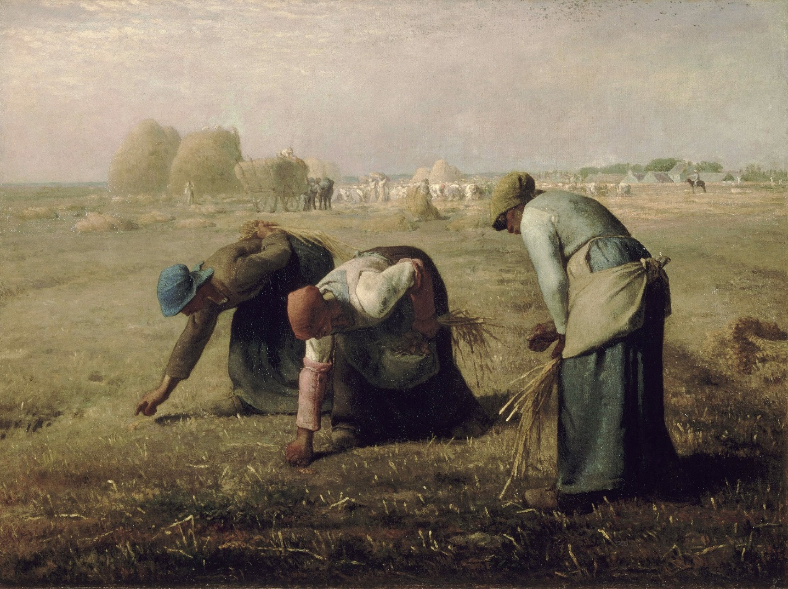
The Gleaners
Oral presentation
Name: 吴晨聪
Class: 能动2

Slide 2
Content
Introduction of The Artist
Appreciation And Analysis
Personal Feelings

Slide 3
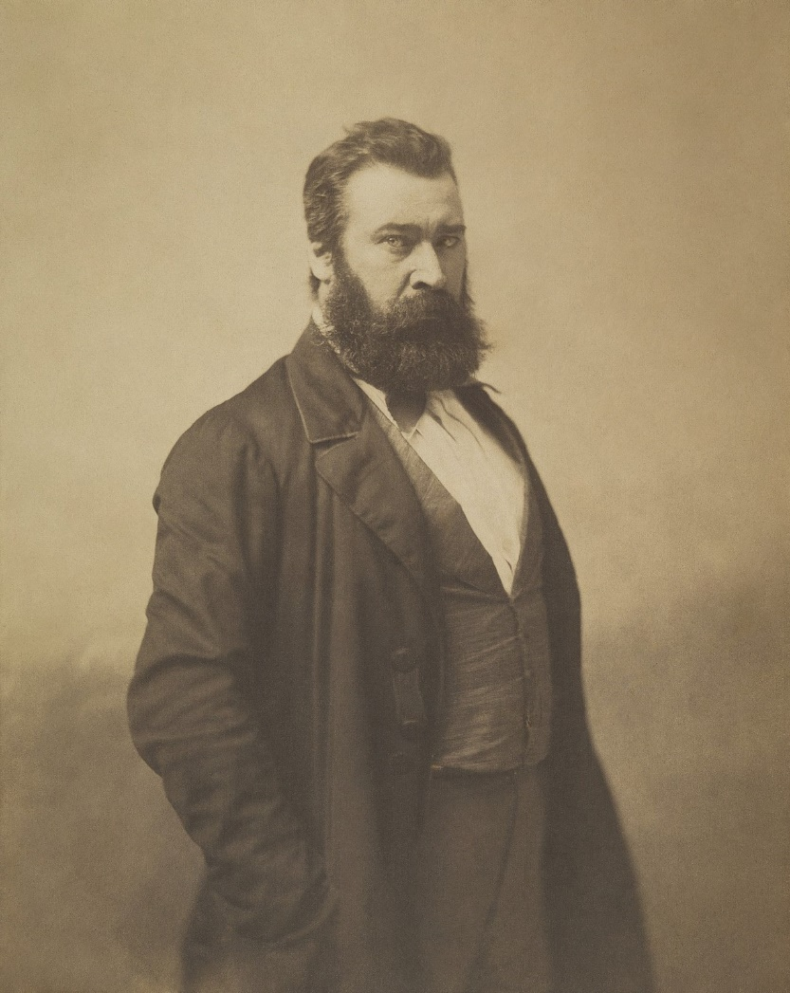
Introduction of The Artist
Jean-Frandik Millet
France artist
Barbizon school style

Slide 4
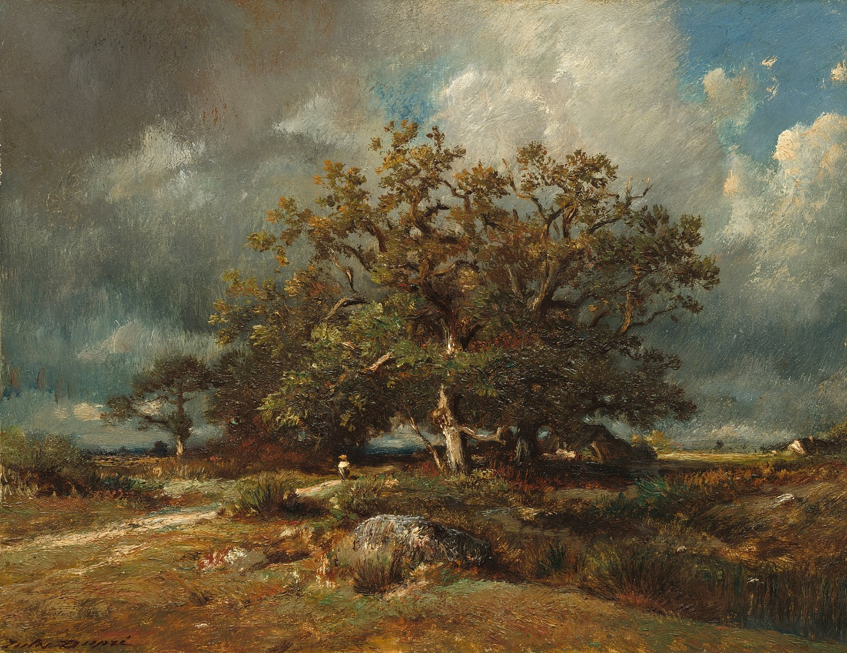
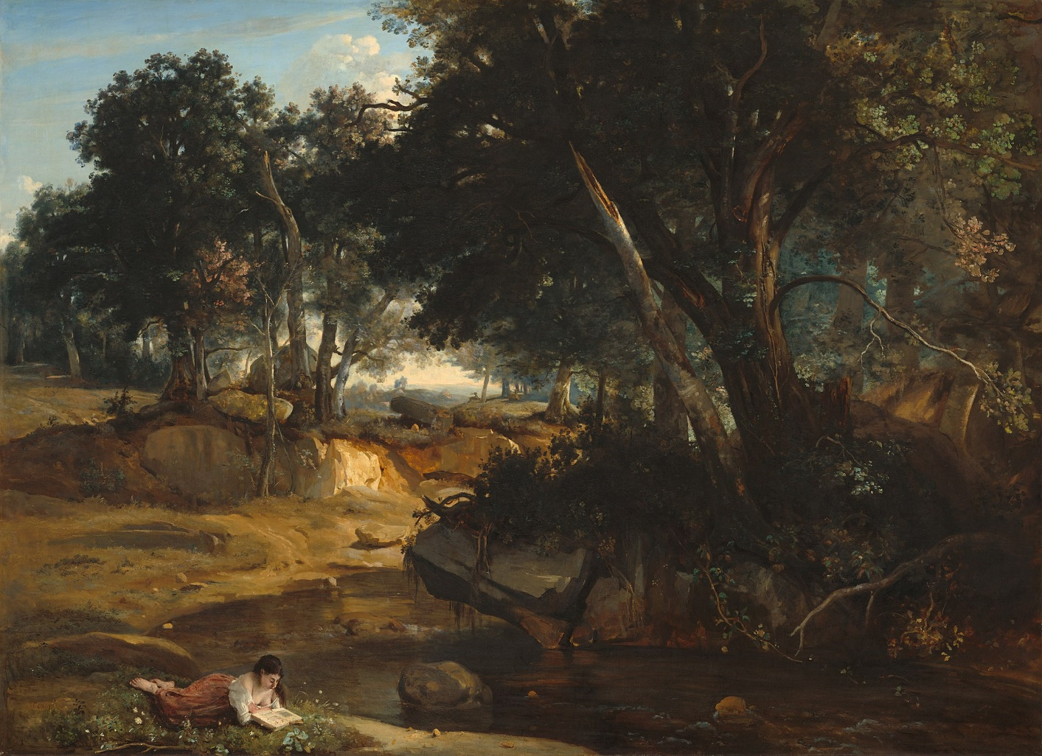
Barbizon school style
The Old Oak
View of the Forest

Slide 5

Appreciation And Analysis
Three ordinary women are picking up the ears of wheat
People and wheat rick behind
Prefect light and distance details
The Gleaners 1857

Slide 6
Personal Feelings
Painting style is easy to understand
Reflecting the reality at that time
Telling people what we should concern
The Gleaners 1857

Slide 7
Thank you!

